Slide 1
Student
Academic
Performance
Group X
Xin Huang
Xinyue Chen
Tzuyi Li
Wanying Li
Ziling Wan
Szufan Chen

Slide 2
AGENDA
Problem
Dataset introduction
Correlation.
Modeling
Data Analysis＆Summary

Slide 3
Business Problem
Academic performance is essential in one’s personal development.
​
Target variable: Average G1, G2,and G3
Correlation plot to see the correlation coefficient

Slide 4
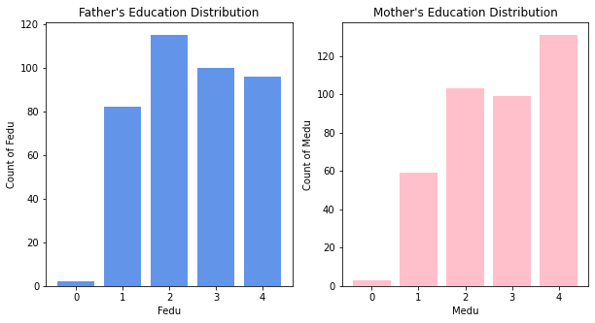
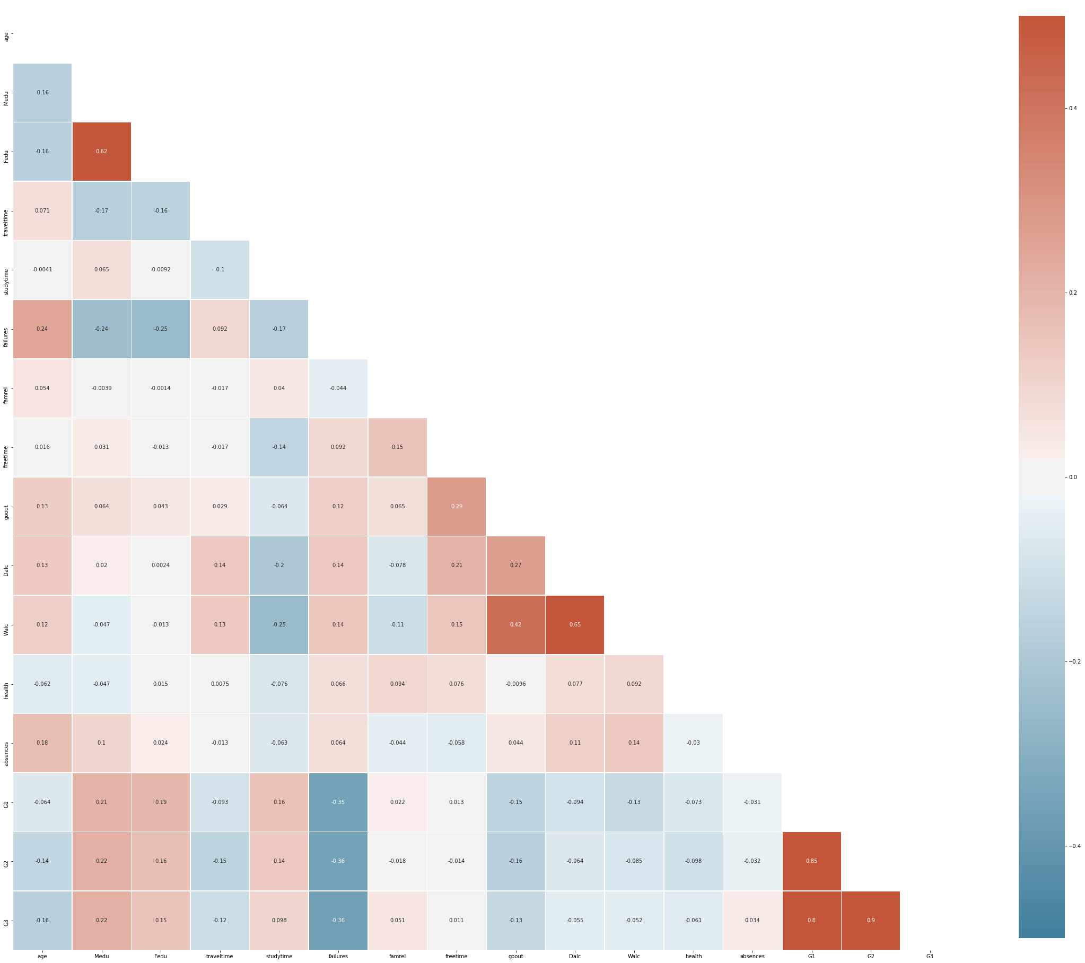
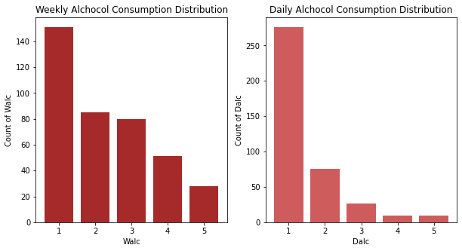
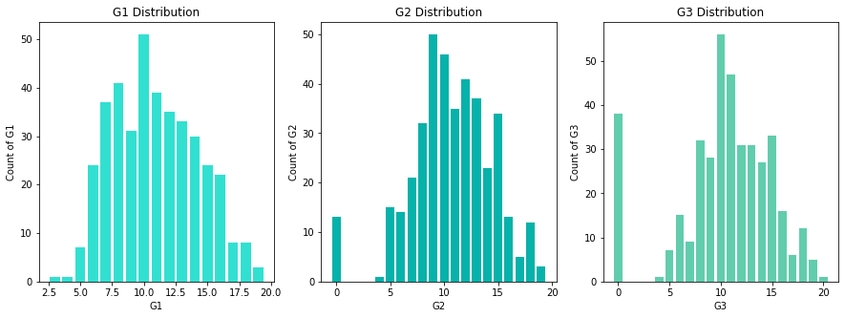
Correlation
4

Slide 5
Modeling
Logistic Regression
precision on test is: 0.77
recall on test is: 0.71
f1 on test is: 0.74
Accuracy on train is: 0.75
Accuracy on test is: 0.70
Important features
Medu 1.208985
Fedu 1.177700
traveltime 1.015240
studytime 0.916806
failures 0.752709
Decision Tree
precision on test is: 0.73
recall on test is: 0.73
f1 on test is: 0.73
Accuracy on train is: 0.74
Accuracy on test is: 0.67
Important features
failures 0.393097
studytime 0.197139
schoolsup_yes 0.122222
Fedu 0.094747
Walc 0.062102

Slide 6
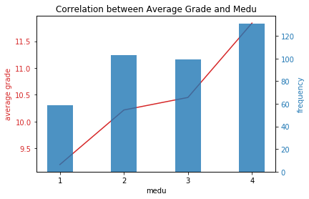
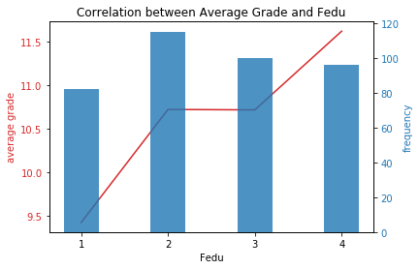
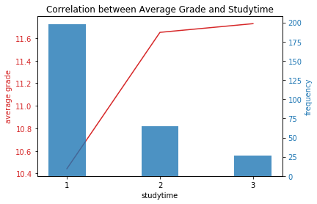
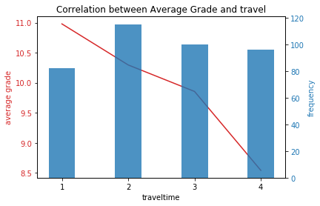
Data Analysis
1
2
3
4

Slide 7
Summary
In our analysis, Parents’ education levels will have an impact on students’ academic performance. Students who study for longer hours tend to perform better. The average grade decreases with the increase of the traffic time.
For students:
More study time
For educational institutions:
Commute bus
After-class tutoring
For parents:
Save students' travel time
Advance education and study with children
Broaden horizons

Slide 8
THANK YOU

